Slide 1
Chapter - 8
Inheritance
Book Referred: Object-Oriented Programming with C++ by E Balaguruswamy
(8th Edition) – Chapter 8
Prepared By: Dr. Anuja Nair, Assistant Professor,
CSE Department, Nirma University

Slide 2
Introduction
Reusability is an important feature of OOP. C+ strongly supports the concept of reusability.
Reusing existing code saves time and money and increases a program’s reliability.
The mechanism of deriving a new class from an old one is called inheritance /derivation / extending classes.
The old class is referred to as base class/superclass/parent class. The new class is called the derived class /subclass/child class.
11

Slide 3
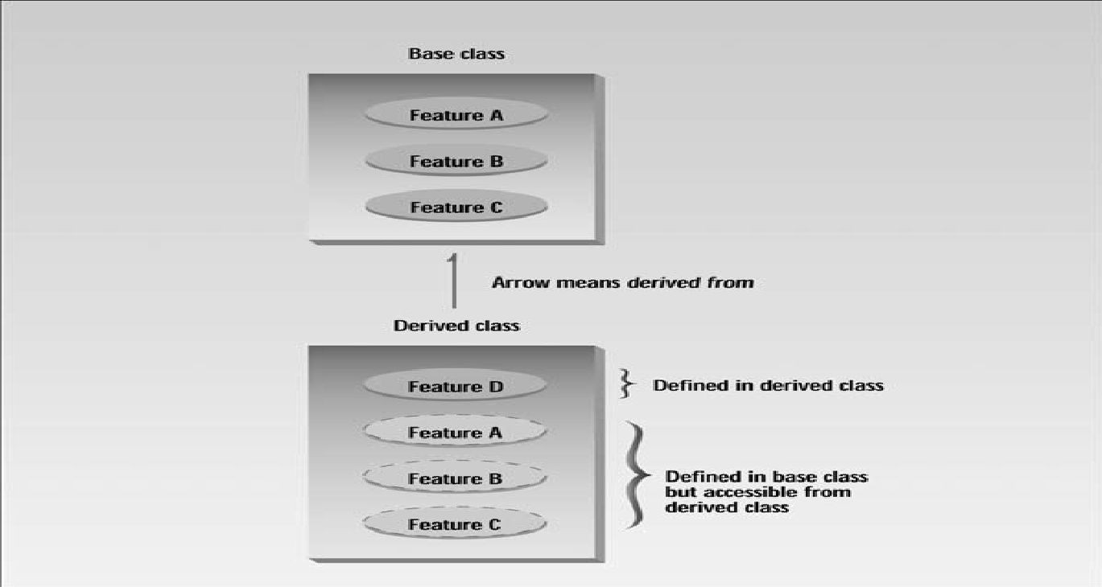
Introduction
The derived class inherits some or all of the traits from the base class.
11

Slide 4
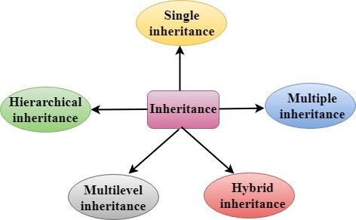
Types of Inheritance
11

Slide 5
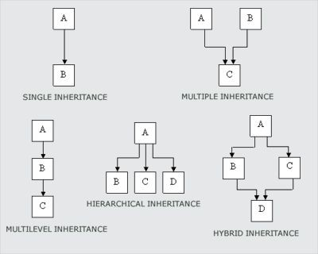
Types of Inheritance
Base → Derived
11

Slide 6
Types of Inheritance
Single inheritance: process of deriving a class from only one base class
Multilevel Inheritance: process of deriving a class from another derived class
Multiple Inheritance: process of deriving a class from two or more base classes.
Hierarchical Inheritance: process of deriving more than one class from a one base class.
Hybrid Inheritance: combination of more than one type of inheritance.

Slide 7
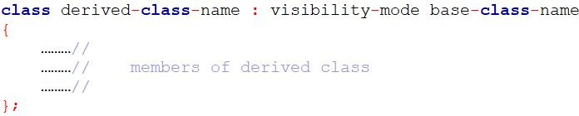
Defining Derived Classes
A derived class can be defined by specifying its relationship with the base class in addition to its own
details.
The colon indicates that the derived-class-name is derived from the base-class-name
The visibility mode is optional and , if present, may be either private or public.
The default visibility mode is
private.
Visibility mode specifies whether the features of the base class are derived privately or publicly.

Slide 8
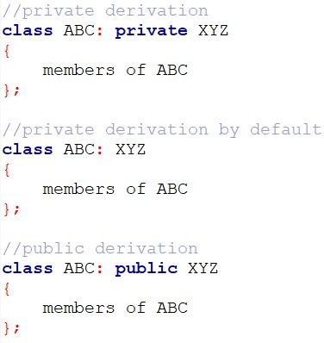
Defining Derived Classes

Slide 9
Visibility Mode
Private Inheritance
Public members of the base class become private members in the derived class.
Therefore, only member functions of the derived class can access them.
Objects of the derived class cannot access base class members directly using the dot (.) operator.
Private inheritance hides the base class interface from outside code → the base class’s public members are no longer accessible through derived objects.
Public Inheritance
Public members of the base class remain public in the derived class.
They are accessible through derived class objects.
Private members of the base class are not inherited and cannot be accessed directly by the derived class.
In both private and public inheritance, private members of the base class are not inherited and cannot be accessed directly by the derived class.

Slide 10
Making Private Member Inheritable
Private member of a base class cannot be accessible in derived class directly.
By modifying the visibility limit of the private member to public would make it accessible to all the other functions of the program, thus taking away the advantage of data hiding.
C++ provides a third visibility modifier, protected, which is accessible by the member functions within its class and any class immediately derived from it.
It can not be accessed by the functions outside these two classes.

Slide 11
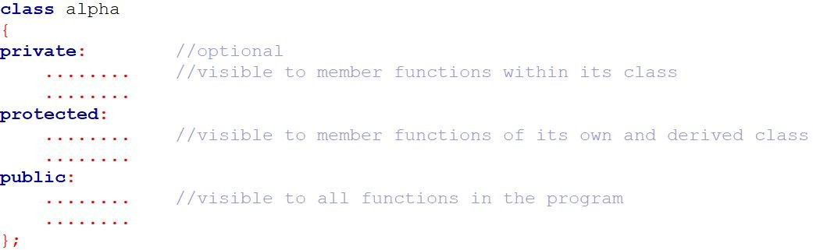
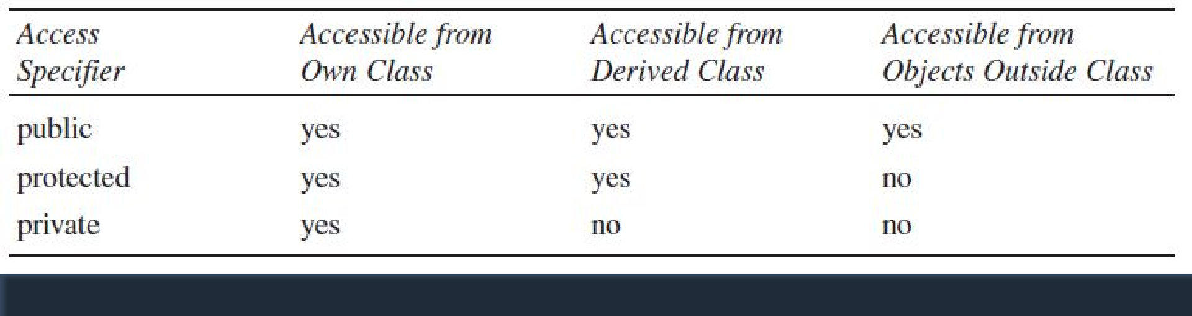
Inheritance and Accessibility
Refer 8a.cpp and 8b.cpp
Only via public/protected functions

Slide 12
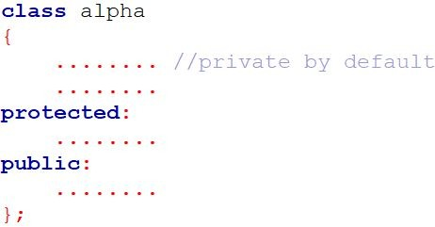
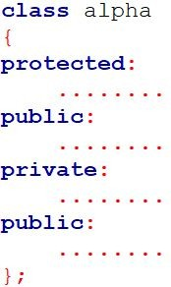
Making Private Member Inheritable
The keywords private, □ However, the normal
protected and public may appear in any order and any number of times.
practice is to use them as follows:
NOTE: It is also possible to inherit base class in protected mode (known as protected derivation)
17

Slide 13
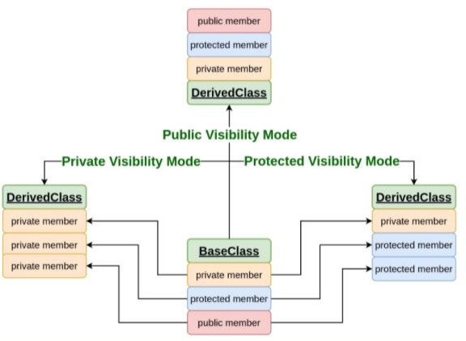
Effect of inheritance on visibility of members
Refer 8c.cpp and 8d.cpp
class Derived : public Base
class Derived : private Base
class Derived : protected Base
Not accessible in Derived with any visibility

Slide 14
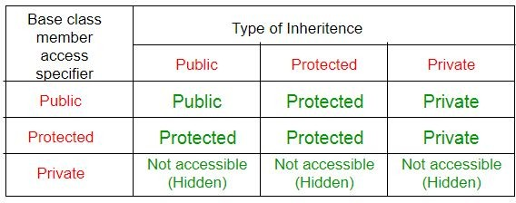
Visibility of inherited members
Refer 8c.cpp and 8d.cpp
Note: A derived class doesn’t inherit access to private data members. However, it does inherit a full parent object, which contains any private members which that class declares.
Memory layout when Derived d statement is executed:
[ Base::secret | Base’s other data | Derived’s own members ]

Slide 15
Access Control to Data Members
Functions that can have access to the private and protected members of a class:
A function that is a friend of the class.
A member function of a class that is a friend of the class.
A member function of a derived class.
Refer 8e.cpp

Slide 16
A function that is a friend of the class
If a function is declared as friend inside a class, it can access private and protected members directly, even though it’s not a member of that class.
class X {
private:
int secret = 42;
friend void show(X obj); // declare friend function
};
void show(X obj) {
cout << obj.secret; // can access private data
}

Slide 17
A member function of a class that is a friend of another class
A whole class can also be made a friend of another class.
Then, all member functions of that friend class can access the private/protected data of the other class.
class X {
private:
int data = 10;
friend class Y; // make class Y a friend of X
};
class Y {
public:
void display(X obj) {
cout << obj.data; // allowed, because Y is friend of X
}
};

Slide 18
A member function of a derived class
A derived class can access the protected members of its base class.
But it cannot access private members directly.
class Base {
protected:
int prot = 20;
private:
int priv = 10;
};
class Derived : public Base {
public:
void show() {
cout << prot; // allowed
// cout << priv; // not allowed
}
};

Slide 19
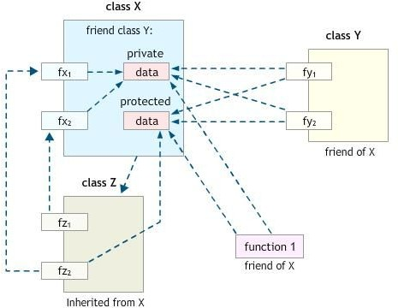
Access Control to Data Members
Refer 8e.cpp

Slide 20
Access Control to Data Members
Refer 8e.cpp
In the image:
Class X has private data and protected data.
Friend function (function1) → can access both private and protected data directly.
Friend class Y → all its functions (fy1, fy2) can also access both.
Derived class Z → inherits from X → can access only protected members, not private ones.
So, the arrows show:
Solid lines = direct member access.
Dotted lines = friendship access.
Dashed lines = inheritance access.

Slide 21
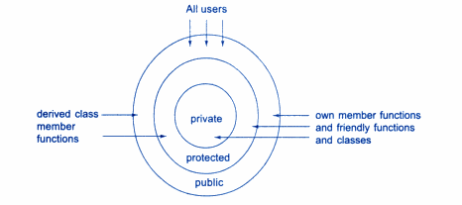
Access Control to Data Members
Type of Function/Class | Access to Private | Access to Protected
Member of same class | Yes | Yes
Friend function of the class | Yes | Yes
Member of friend class | Yes | Yes
Derived class member function | No | Yes
Unrelated function/class | No | No
Refer 8e.cpp

Slide 22
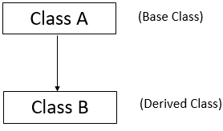
Single Inheritance
In single inheritance, a class is allowed to inherit from only one class. i.e. one subclass is inherited by one base class only.

Slide 23
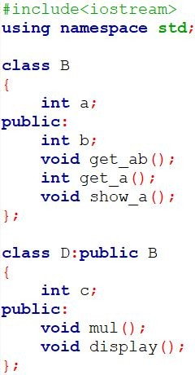
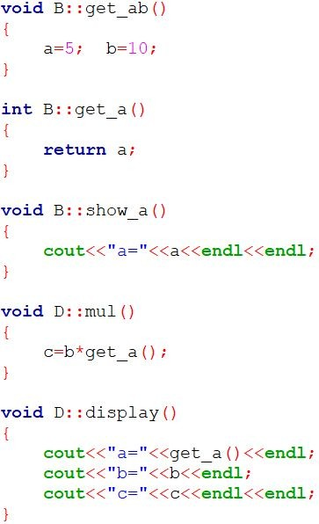
Single Inheritance: Public derivation

Slide 24
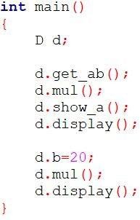

Single Inheritance: Public derivation

Slide 25
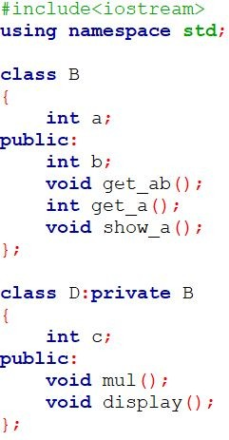
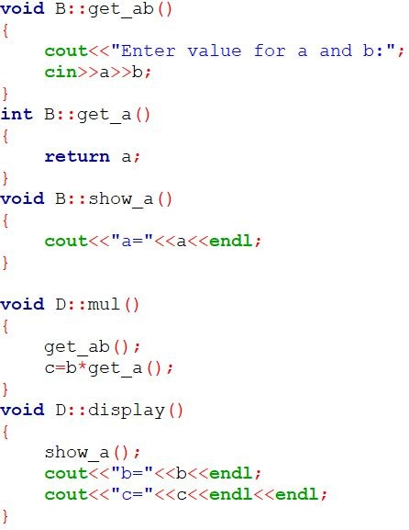
Single Inheritance: Private derivation

Slide 26
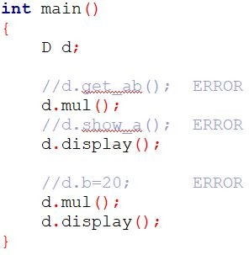
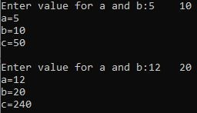
Single Inheritance: Private derivation

Slide 27
Question 1 : Single Inheritance
Define a Base Class Vegetable having data member Color and member function getdata() which takes color as an input and putdata() which print the color as an output. Vegetable Class has one subclass named Tomato having data members weight and size and member function gtdata() which takes weight and size as an input and ptdata() which prints weight and size as output. Write a C++ Program which inherits the data of Vegetable class in Tomato class using Single Inheritance.

Slide 28
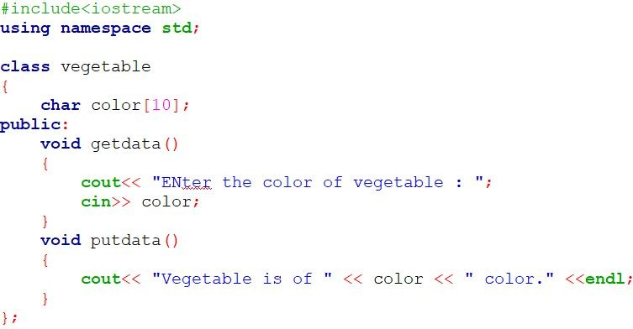
Solution

Slide 29
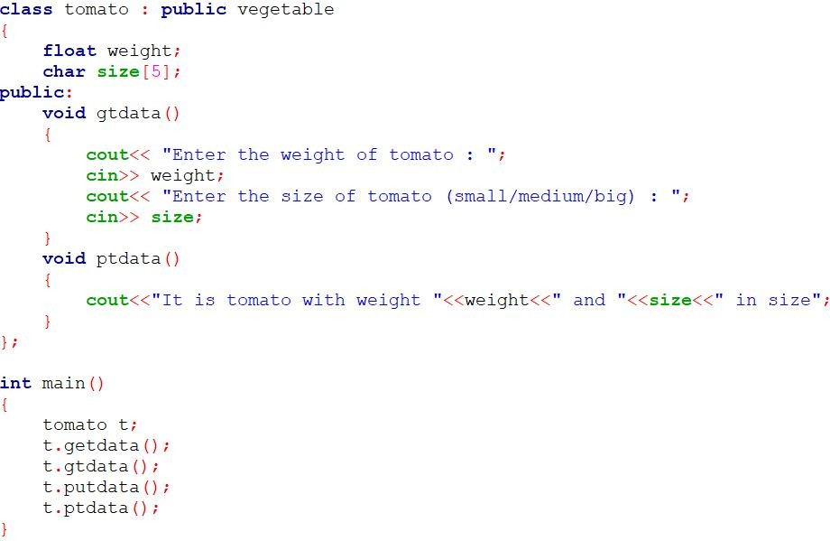

Practical :Single Inheritance
Solution

Slide 30
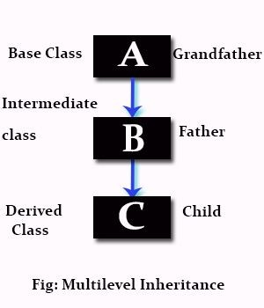
Multilevel Inheritance
The class A serves as a base class for the derived class B, which in turn serves as a base class for the derived class C.
The class B is known as intermediate base class since it provides a link for the inheritance between A and C.
The chain ABC is known as
inheritance path.
NOTE: The process can be extended to any number of levels

Slide 31
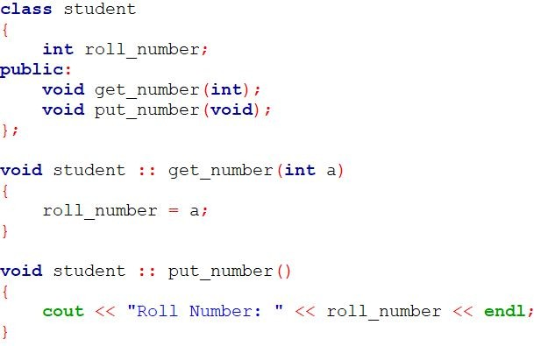
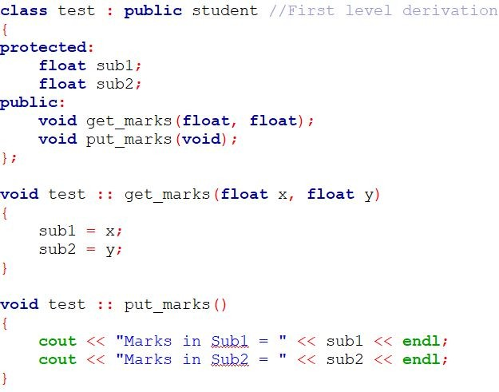
Multilevel Inheritance

Slide 32
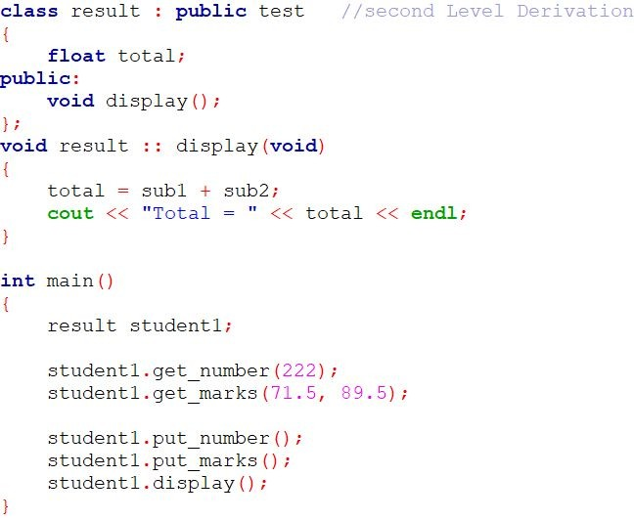

Multilevel Inheritance

Slide 33
Question 2 : Multilevel Inheritance
Create a class shape having data member shape_name and member function to get and print shape_name. Derive a Class Circle which is inherited publicly from class shape and having data members radius of a circle and member function to get and print radius of a circle. Derive a Class Area which is inherited publicly from Class Circle and having data members area_of_circle and member function display () which displays area of a circle. Use object of class Area in main () function and get and display all the information.
Use the concepts of Multilevel Inheritance.

Slide 34
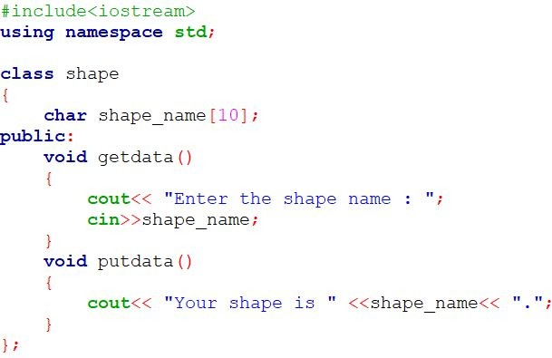
Solution

Slide 35
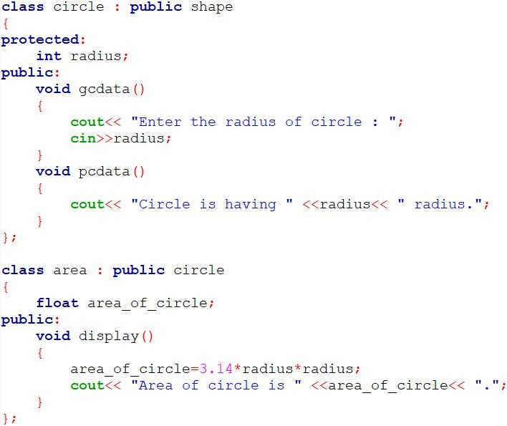
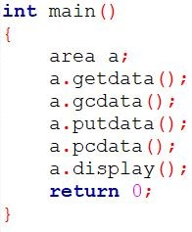
Solution
17

Slide 36

Multiple Inheritance
A class can inherit the attributes of two or more classes is known as multiple inheritance.
It allows us to combine the features of several existing classes as a starting point for defining new classes.
It is like a child inheriting the physical features of one parent and the intelligence of another.

Slide 37
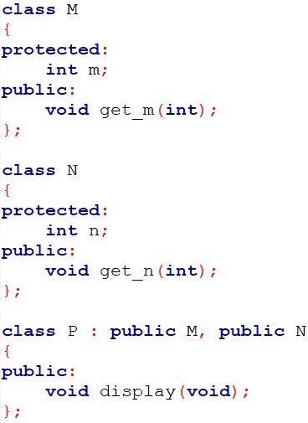
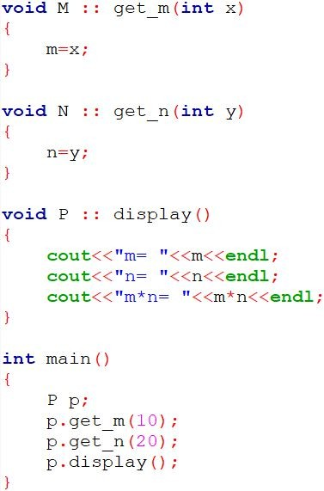

Multiple Inheritance

Slide 38
Ambiguity Resolution in Inheritance
Ambiguity may arise in inheritance application, when the function in derived class overrides the inherited function.
A call to function with same name in base class and derived class by derived class object will invoke function defined in derived class only.
However, we may invoke the function defined in base class by using the scope resolution operator.

Slide 39
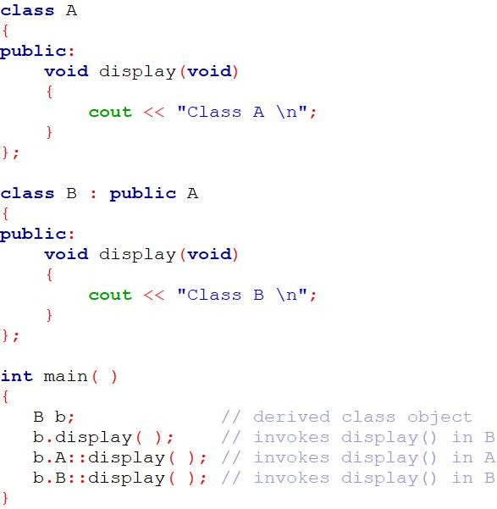

Ambiguity Resolution in Inheritance
In Single Inheritance

Slide 40
Ambiguity Resolution in Inheritance
We may also face a problem in using the multiple inheritance, when a function with the same name appears in more than one base class.
We can solve this problem by defining a named instance within derived class, using the class resolution operator with the function.

Slide 41
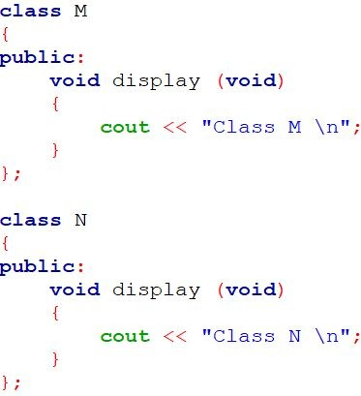
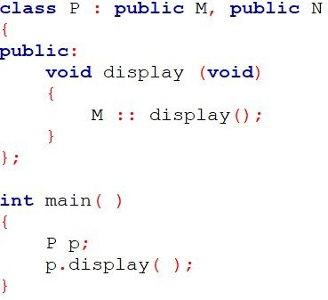
Ambiguity Resolution in Inheritance
In Multiple Inheritance
Refer 8g.cpp

Slide 42
Constructors in Derived Classes
We know that constructor is invoked implicitly when an
object is created.
In inheritance, when we create object of derived class, what will happen?

Slide 43
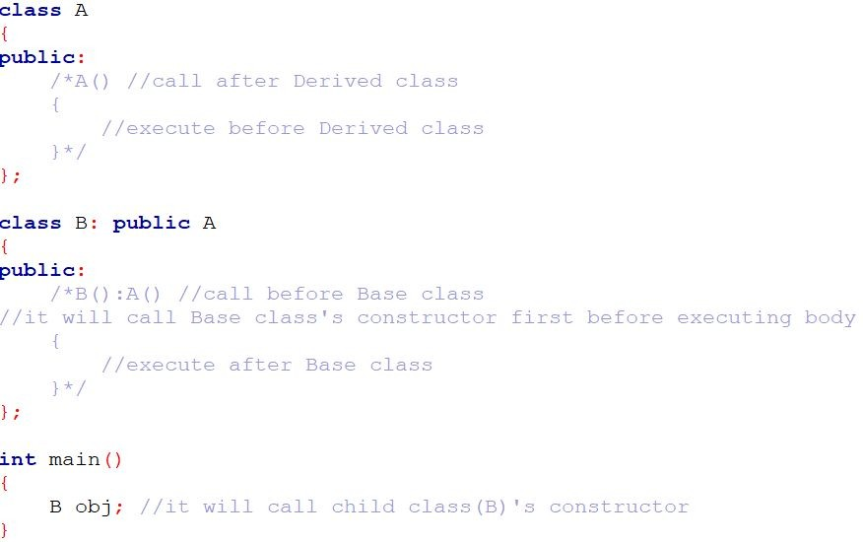
Constructors in Derived Classes
Compiler’s Default Constructor in case of inheritance

Slide 44
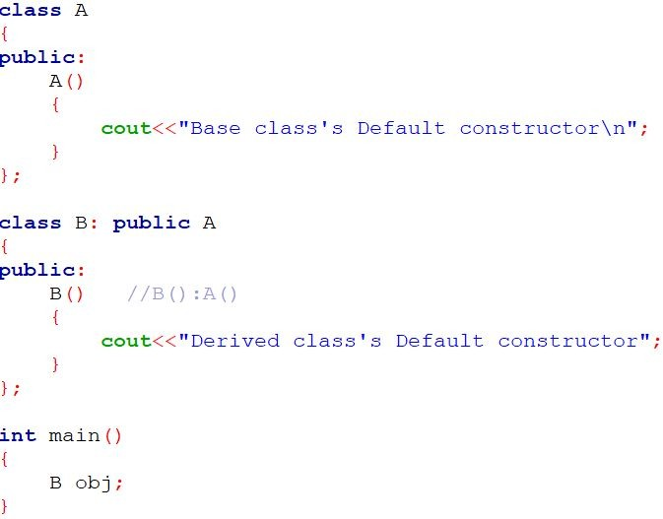

Constructors in Derived Classes
User’s Default Constructor in case of inheritance

Slide 45
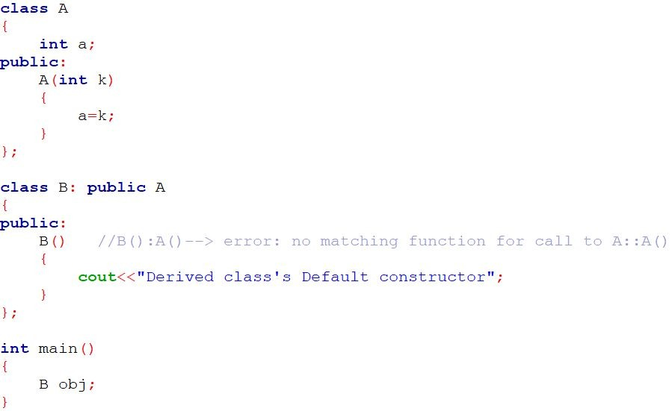
Constructors in Derived Classes
NOTE:
As long as no base class constructor takes any arguments, the derived class need not have a constructor function.
However, if any base class contains a constructor with one or more arguments, then it is mandatory for the derived class to have a constructor, call base class’s constructor explicitly and pass the arguments to the base class constructors.

Slide 46
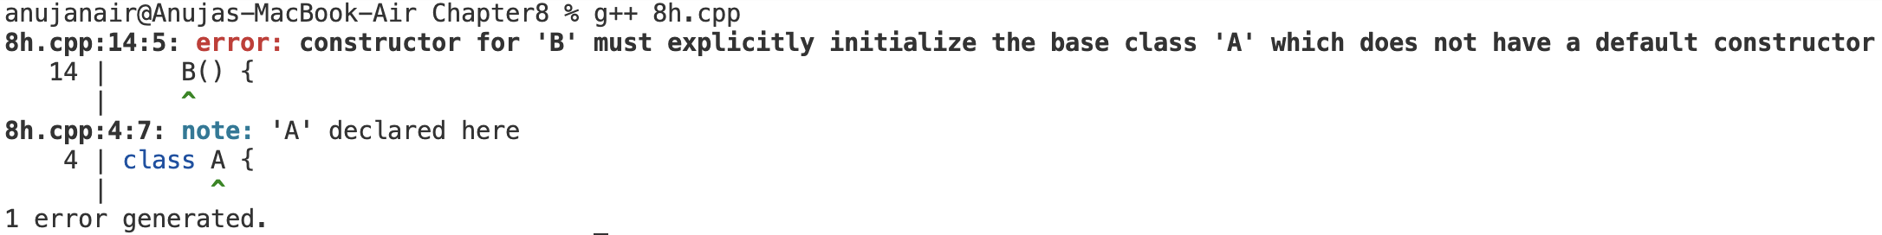
Constructors in Derived Class
Refer 8h.cpp and 8h_1.cpp
What happens here
Class A has a parameterized constructor → A(int k)
Because of this, A does not have a default constructor (compiler doesn’t generate one automatically).
Class B inherits from A.
When we create an object B obj; → the Base class constructor must be called first. But since A doesn’t have a no-argument (default) constructor, the compiler doesn’t know how to initialize A.
That’s because B() tries to call the default constructor of A, but A() doesn’t exist — only A(int) does.

Slide 47
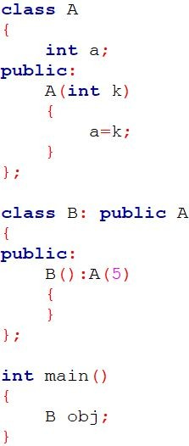
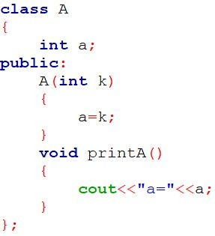
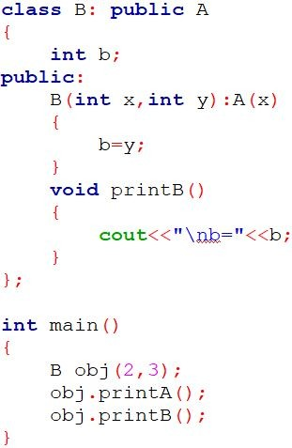

Constructors in Derived Classes
Refer 8i.cpp

Slide 48
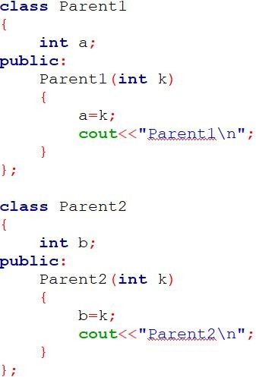
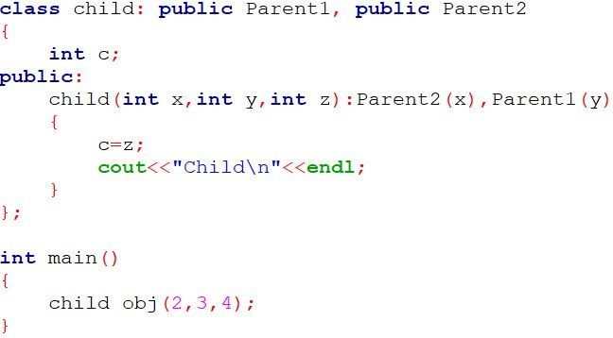

Constructors in Derived Classes
Refer 8j.cpp
NOTE: In case of multiple inheritance, The base class constructors are called in the order in which they are declared in the inheritance list, not in the order written in the initializer list.

Slide 49
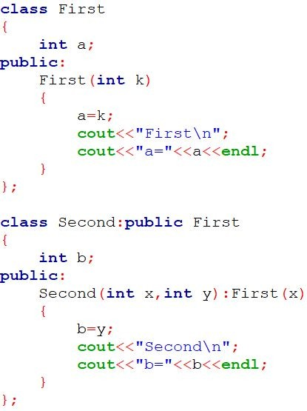
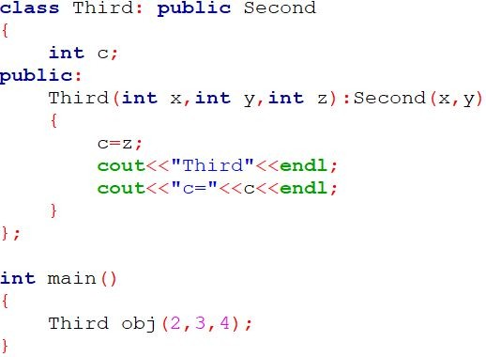

Constructors in Derived Classes
Refer 8k.cpp
NOTE: In case of multilevel inheritance, the constructors will be executed in the order of inheritance.

Slide 50

Constructors in Derived Classes
C++ supports another method of initializing the class objects.
This method uses what is known as initialization list in the constructor function.
We can use initialization-section to provide initial values to the base constructor and also to initialize its own class members.
We can use either/both section(assignment as well as initialization) to initialize the data members of the constructor.

Slide 51
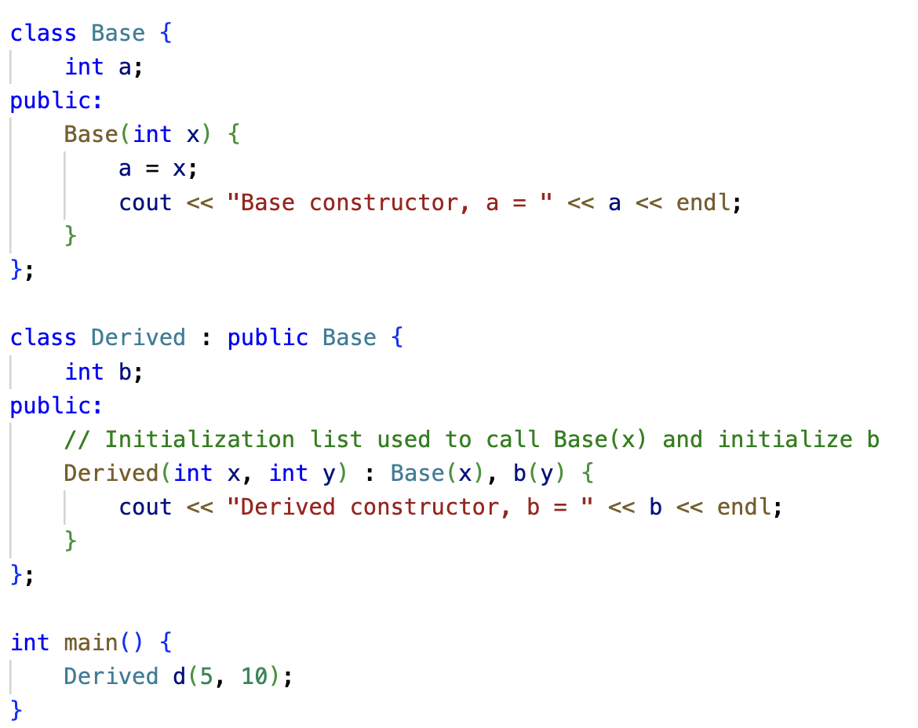
Constructors in Derived Classes
Refer 8l.cpp

Slide 52
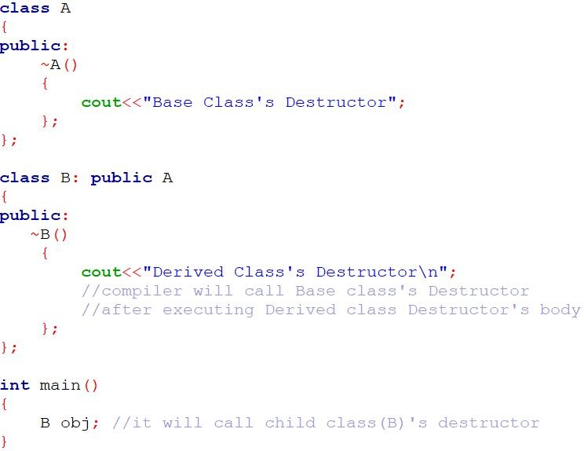

Destructor in Inheritance

Slide 53
Destructor in Inheritance
Inheritance Type | Constructor Order | Destructor Order
Single | Base → Derived | Derived → Base
Multiple | In order of base class declaration | Reverse order
Multilevel | Top → Middle → Bottom | Bottom → Middle → Top
Refer 8m_1.cpp and 8m_2.cpp

Slide 54
Question 3 : Multiple Inheritance
Create a Class alpha having data member: int x and one argument constructor which initializes the value of x. It also has member function which displays the value of x. Create another class beta which contains data member: float y and one argument constructor which initializes the value of y. It also has member function which displays the value of y. Create a Class Gamma which publicly inherits from class alpha and class beta and has two data members: int m, n and a constructor which passes argument to the base class constructor as well as initializes its own data members. Class Gamma also has member function to print the values of m and n. Write main function which creates object of class Gamma which passes values of base class constructor as well as derived class constructor.
Use the concept of Multiple Inheritance and Constructor in Derived Class.

Slide 55
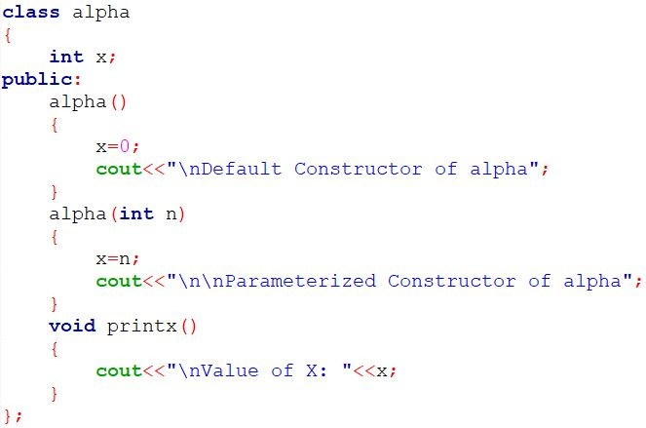
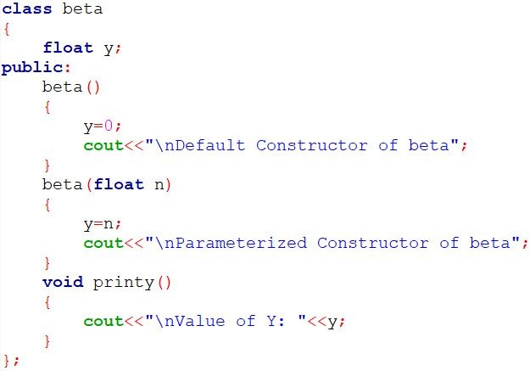
Solution

Slide 56



Solution

Slide 57


Hierarchical Inheritance
Many Programming problems can be cast into a hierarchy where certain features of one level are shared by many others below that level
The base class will include all the features that are common to the subclasses.
A subclass can be constructed by inheriting the properties of the base class.
A subclass can serve as a base class for the lower level classes and so on

Slide 58



Hierarchical Inheritance
Refer 8n.cpp

Slide 59
Function Overriding
Function Overriding happens when:
A derived class defines a function with the same name, parameters, and return type as in the base class.
The base class function is marked as virtual.
When called via a base class pointer or reference, the derived version executes (runtime polymorphism).
Virtual Functions - Part of Chapter 9
Without virtual, the base version of a function is called (compile-time binding).
With virtual, the derived version is called (runtime binding). Virtual allows runtime polymorphism (decides function call based on object type, not pointer type).
Refer 8f.cpp and 8n_1.cpp

Slide 60
Question 4 :Hierarchical Inheritance
Write a program to create a class Medicine which stores type of medicine, name of company, date of manufacturing. Class Tablet is inherited from Medicine. Tablet class has name of tablet, quantity per pack, price of one tablet as members. Class Syrup is also inherited from Medicine and it has quantity per bottle, dosage unit as members. Both the classes contain necessary member functions for input and output data. Write a main( ) that enter data for tablet and syrup, also display the data.
Use the concepts of Hierarchical Inheritance.

Slide 61

Solution

Slide 62

Solution

Slide 63

Solution

Slide 64


Solution

Slide 65

Hybrid Inheritance
There could be situations where we need to apply two or more types of inheritance.
For instance, consider the following Fig. where result will have both multilevel and multiple inheritance

Slide 66

Hybrid Inheritance

Slide 67



Hybrid Inheritance

Slide 68

Virtual Base Classes
Consider the situation where we have one class Grandparent .This class is inherited by two other classes Parent1 and Parent2. Both these class are inherited into a new class child as shown in figure below.
As we can see from the figure that data members/function of class Grandparent are inherited twice to class child. One through class Parent1 and second through class Parent1.

Slide 69
Virtual Base Classes
When any data / function member of class Grandparent is accessed by an object of class child, ambiguity arises as to which data/function member would be called?
One inherited through Parent1 or the other inherited through Parent2. This confuses compiler and it displays error.

Slide 70

Virtual Base Classes
Refer 8o.cpp

Slide 71

Virtual Base Classes
To resolve this ambiguity when class Grandparent is inherited in both class Parent1 and class Parent2, it is declared as virtual base class by placing a keyword virtual as :
Note:
virtual can be written before or after the public.
Now only one copy of data/function member will be copied and class Grandparent becomes the virtual base class.

Slide 72

Virtual Base Classes
NOTE:
When a class is made virtual base class, C++ takes necessary care to see that only one copy of that class is inherited, regardless of how many inheritance path exist between the virtual base class and a derived class

Slide 73

Virtual Base Classes
69

Slide 74



Virtual Base Classes

Slide 75
Question 5 : Hybrid Inheritance
Define a class Hospital having rollno and name as data members and member function to get and print data. Derive a class Ward from class Hospital having data members: ward number and member function to get and print data. Derive another class Room from Hospital having data member bed number and nature of illness and member function to get and print data. Derive class Patient from Class Ward and Class Room. In main () declare 5 object of Class Patient and get and display all the information.
Use the concept of Virtual Base Class and Hybrid Inheritance.

Slide 76

Solution

Slide 77


Solution

Slide 78

Solution

Slide 79



Constructors in Derived Classes
The constructors for virtual base classes are invoked before any non-virtual base classes.
If there are multiple virtual base classes, they are invoked in the order in which they are declared. Any non-virtual
bases are then constructed before the derived class constructor is executed.
Method of inheritance
Order of execution
A(); base constructor B(); derived constructor
B(); base(first)
C(); base(second) A(); derived
C() ; virtual base B(); ordinary base A(); derived

Slide 80
Abstract Classes
Refer 8p.cpp
An abstract class is one that is not used to create objects.
It is designed only to act as a base class (to be inherited by other classes)
It is a design concept in program development and provides a base upon which other classes may built.
An abstract class is a class that cannot be instantiated directly.
It acts as a blueprint for other classes.

Slide 81
Pure Virtual Function
Refer 8p.cpp
A pure virtual function is a virtual function that has no definition in the base class.
It’s declared using = 0.
It makes the class abstract, meaning you cannot create objects of it.

Slide 82
Difference between virtual function and pure virtual function
Feature | Virtual Function | Pure Virtual Function
Definition in Base | Has a body (implementation) | No body (= 0)
Overriding in Derived | Optional | Mandatory
Instantiation of Base Class | Allowed | Not allowed (abstract class)
Purpose | Enables polymorphism | Enforces polymorphism
Default Behavior | Can be used as-is | Must be overridden
Example Use Case | Common behavior that derived can customize | Interface design (abstract behavior)
virtual → provides choice (base class gives a default).
= 0 → provides force (derived class must define it).

Slide 83
Member Classes: Nesting of Classes
Is-a relationship: Inheritance is a Is-a relationship
Ex: BMW is-a car [Here, BMW & car are classes]
Has-a relationship: Composition is a Has-a relationship
Ex: Car has-a engine [Here, Car & engine are classes]
What is Nested class?
A nested class is a class that is declared in another class
It implements the concept of “has-a” relationship.

Slide 84


Member Classes: Nesting of Classes
Syntax 1 Syntax 2

Slide 85
Member Classes: Nesting of Classes
Defining Nested class inside the Enclosing class
Nested class as private
Nested class as public
Defining Nested class outside the Enclosing class

Slide 86



Defining Nested class inside the Enclosing class
Nested class as public
Refer 8q.cpp
69

Slide 87



Defining Nested class inside the Enclosing class
Nested class as public
69

Slide 88



Defining Nested class inside the Enclosing class
Nested class as private
69

Slide 89
Inner/Nested Class
The inner class is a member of the outer class, just like a function or variable.
So, to access it outside, we must scope it properly using Outer::Inner.

Slide 90

Defining Nested class outside the Enclosing class
C++ supports another way of inheriting classes:
An object can be collection of many other objects (A class can contain objects of other classes as its members)
All objects of gamma class will contain the objects a and b.
This kind of relationship is called
containership or nesting

Slide 91
Defining Nested class outside the Enclosing class
Creation of an object that contains another object is very different than the creation of an independent object.
An independent object is created by its constructor
when it is declared with arguments.
A nested object is created in two stages:
The member objects are created using their respective constructors.
Then ordinary members are created.

Slide 92

Defining Nested class outside the Enclosing class
This means Constructors of all the member objects should be called before its own constructor body is executed.

Slide 93



Defining Nested class outside the Enclosing class

Slide 94
Thank You

